Slide 1


Movie Recommender System
By: Omar Mohy – A’isha Ahmad
Supervised By: Dr. Ali Wagdy

Slide 2

Contents:
Abstract.
Introduction.
Related Work.
Methodology.
Experimental Results.
Conclusion.
Future Research Directions.

Slide 3
Introduction

Slide 4


What is Recommender System?

Slide 5

Recommender System Importance:
Loyalty and satisfaction.
Enhance user’s experience.
Develops Trust.
Increase sales and revenue.
RS

Slide 6
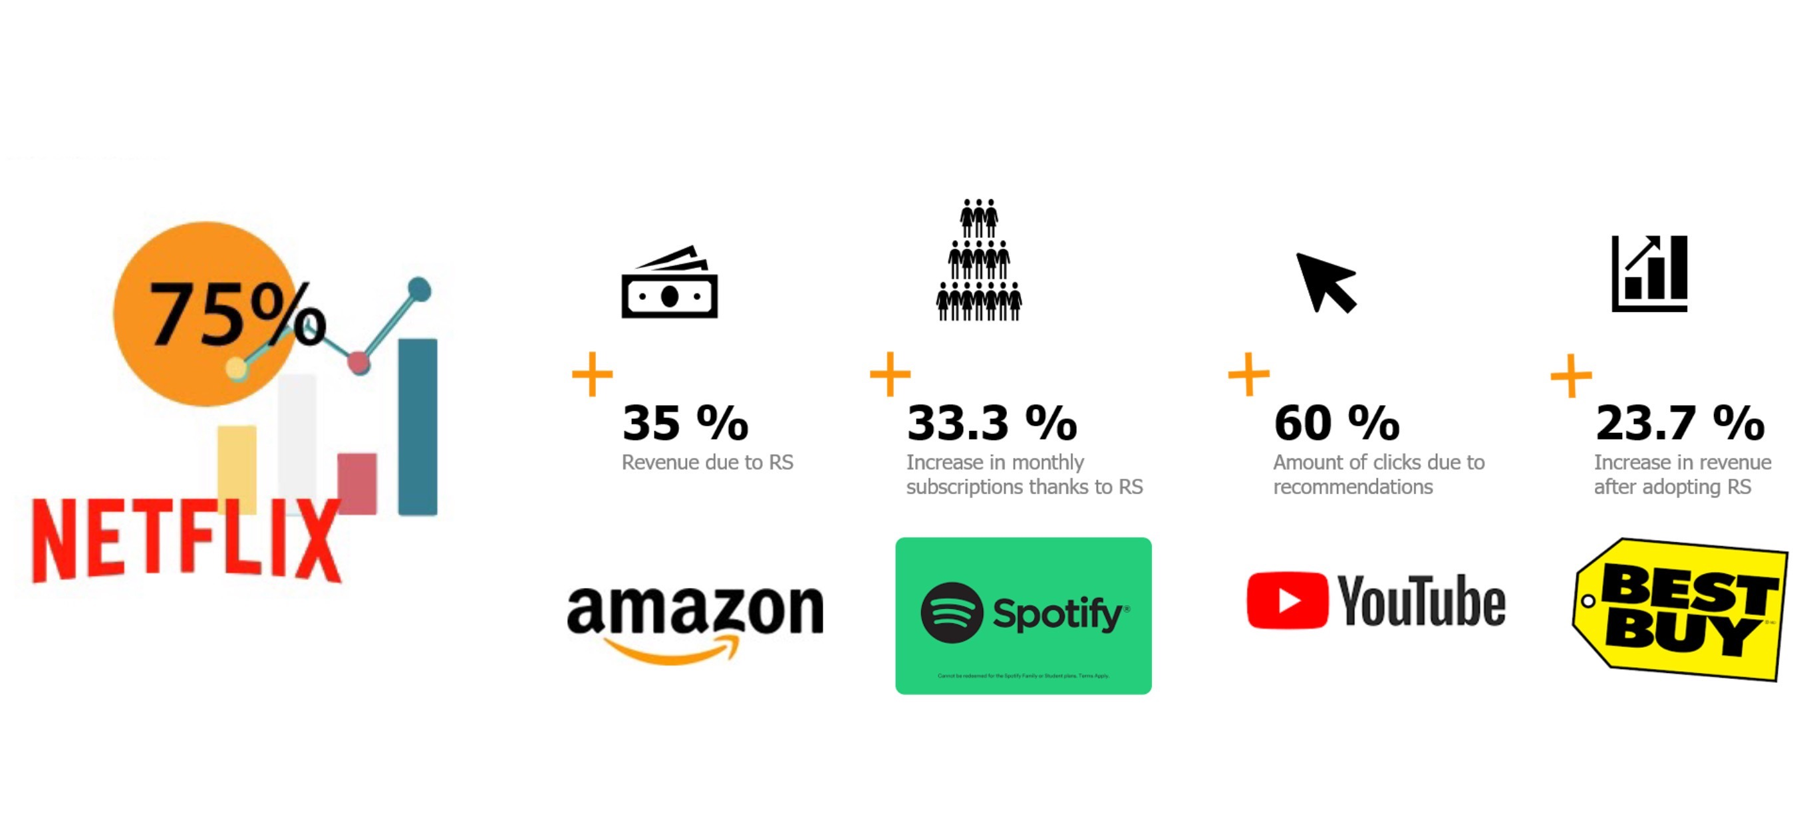
Recommender System in Numbers:

Slide 7
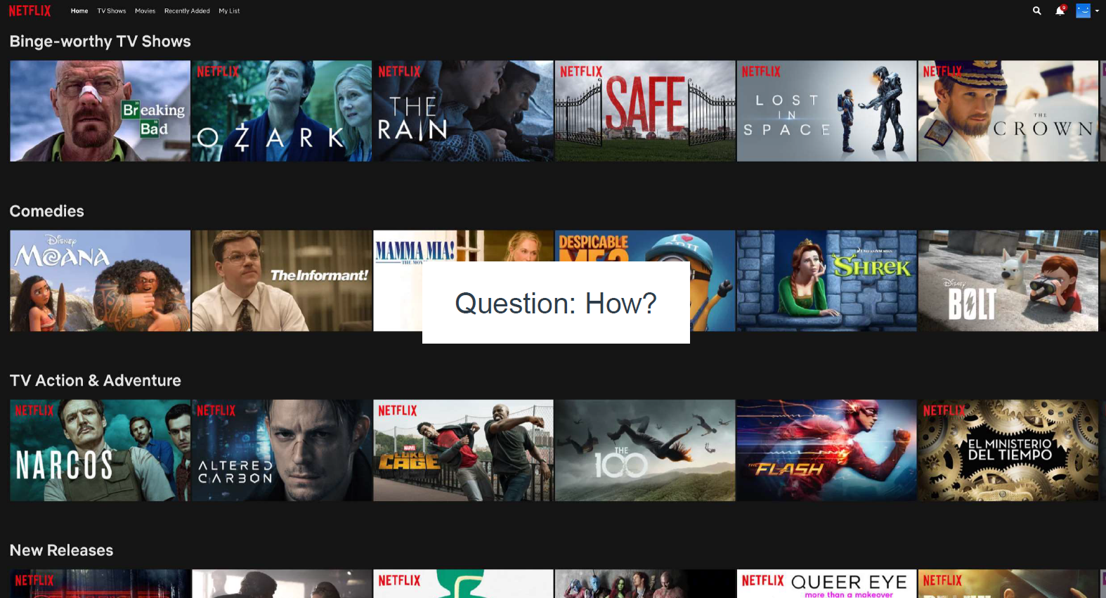
Project Description – Movie Recommendation

Slide 8
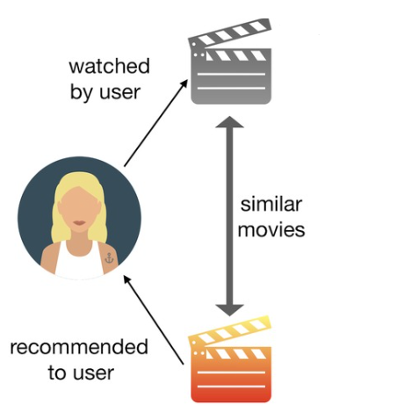
Project Goal:
In this project our goal is to provide users with relevant movie recommendation that they will actually like and pick the best possible algorithm based on lowest RMSE.

Slide 9
Abstract

Slide 10
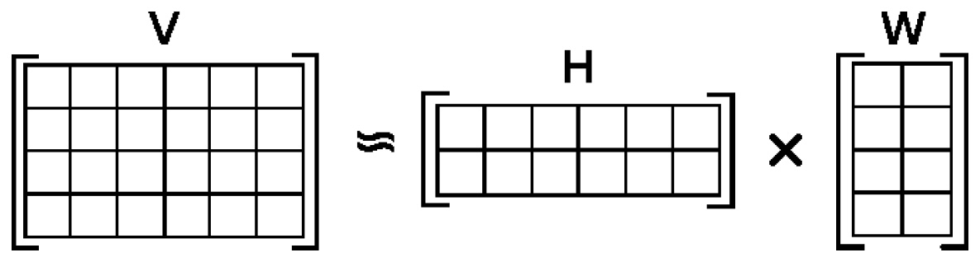
Matrix Factorization Techniques:

Slide 11
Related Work

Slide 12
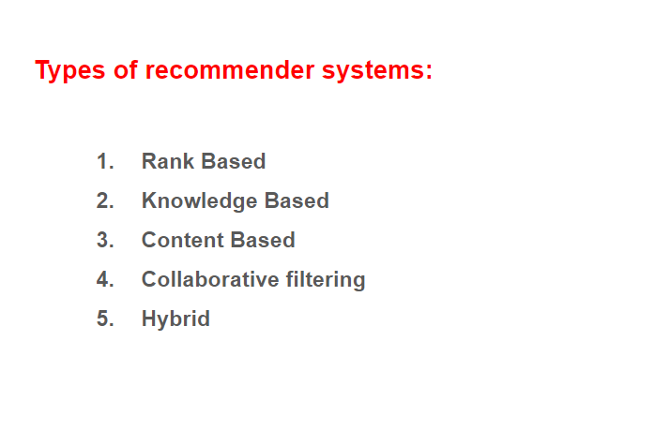
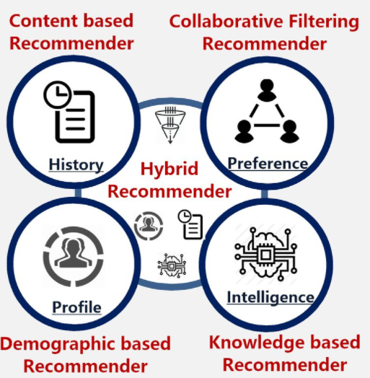
Types of Recommender Systems:

Slide 13
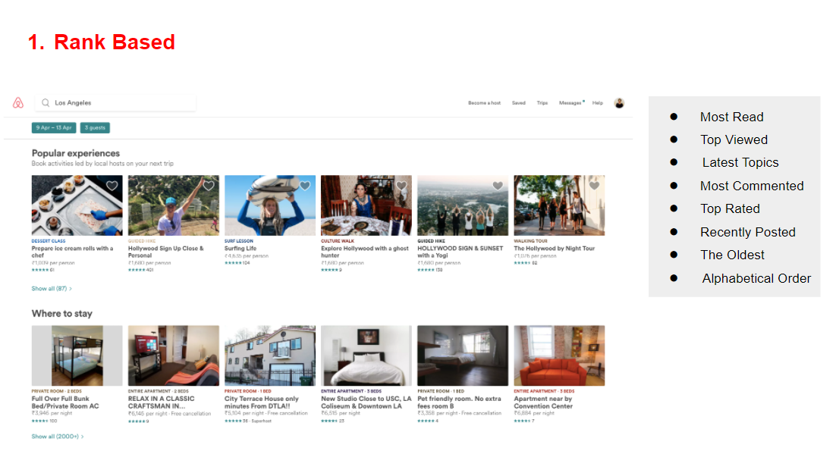

Slide 14
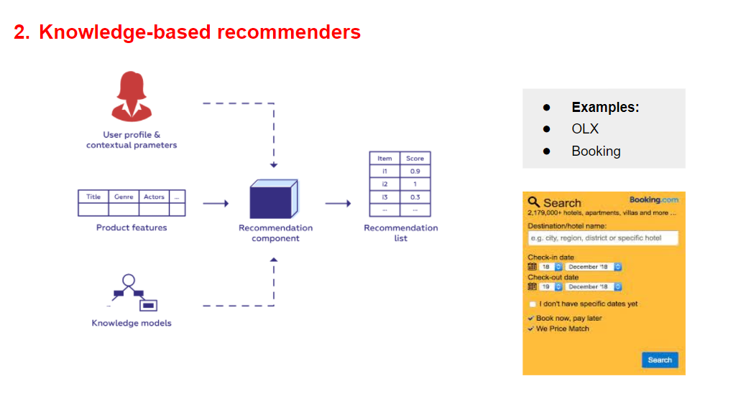

Slide 15
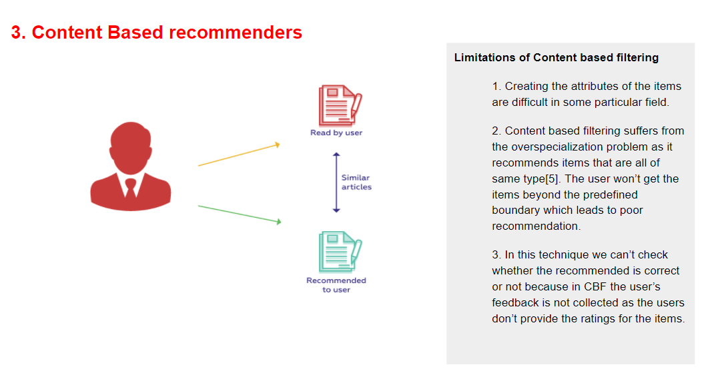

Slide 16
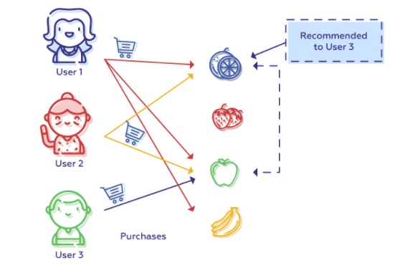
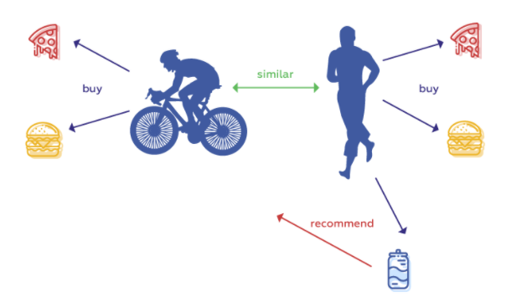
Collaborative Filtering:

Slide 17
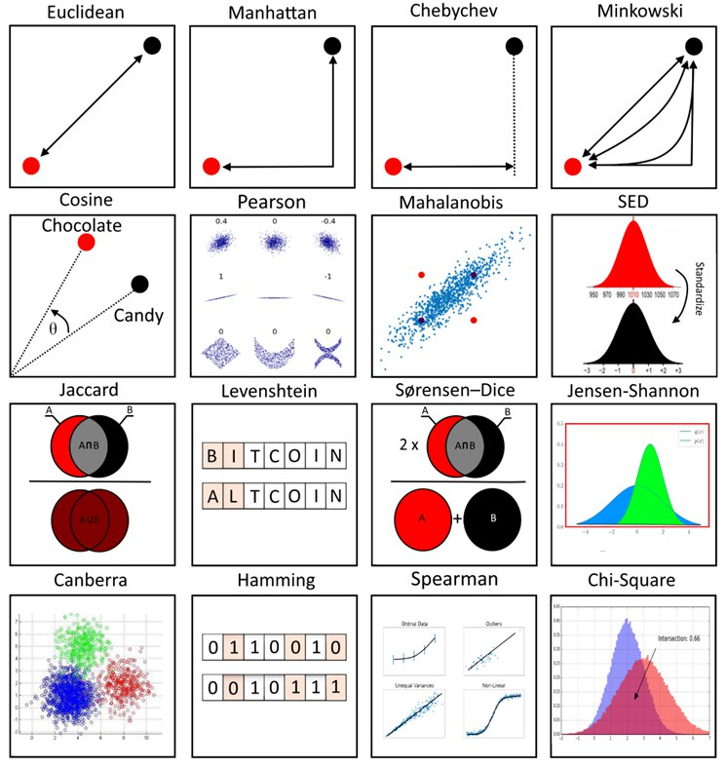
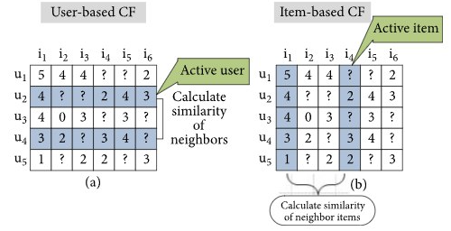
Neighborhood Models:

Slide 18
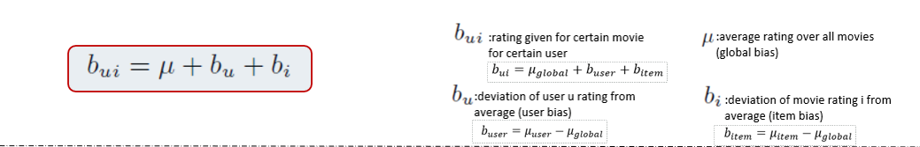
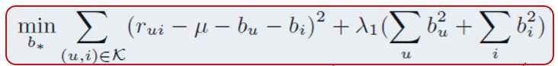
Baseline Estimate:

Slide 19
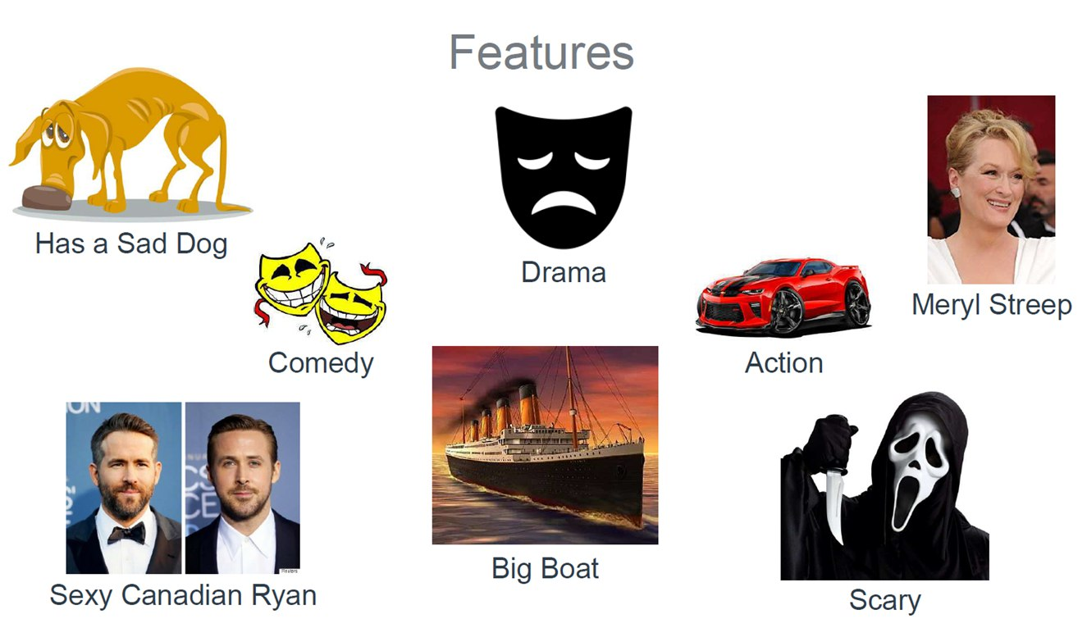
Are Ratings Only Enough?

Slide 20
Methodology

Slide 21
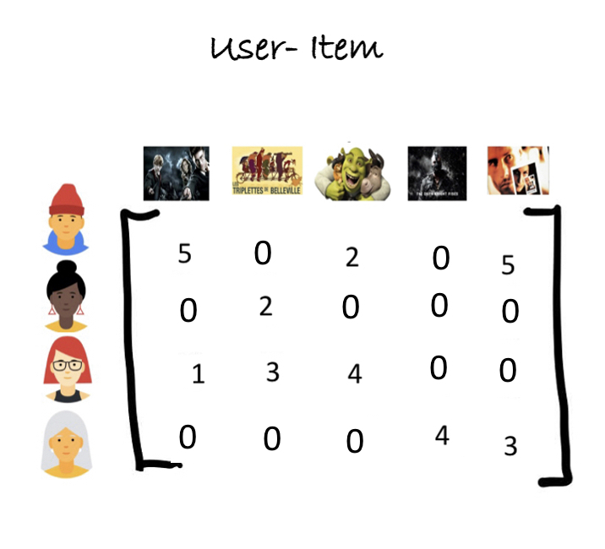
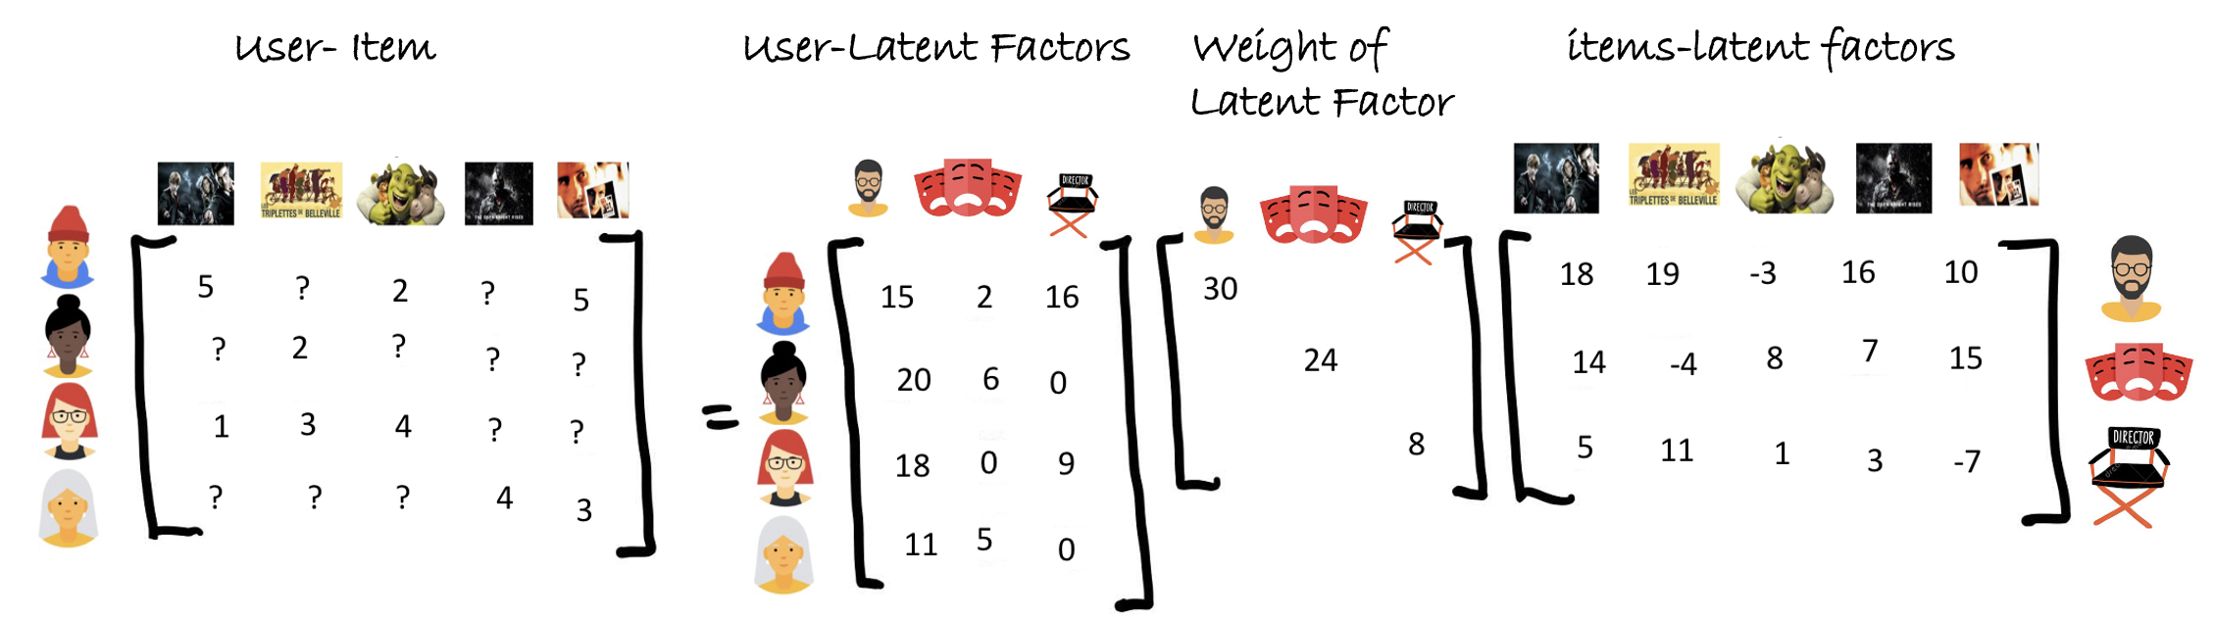
Singular Value Decomposition (SVD):
SVD

Slide 22
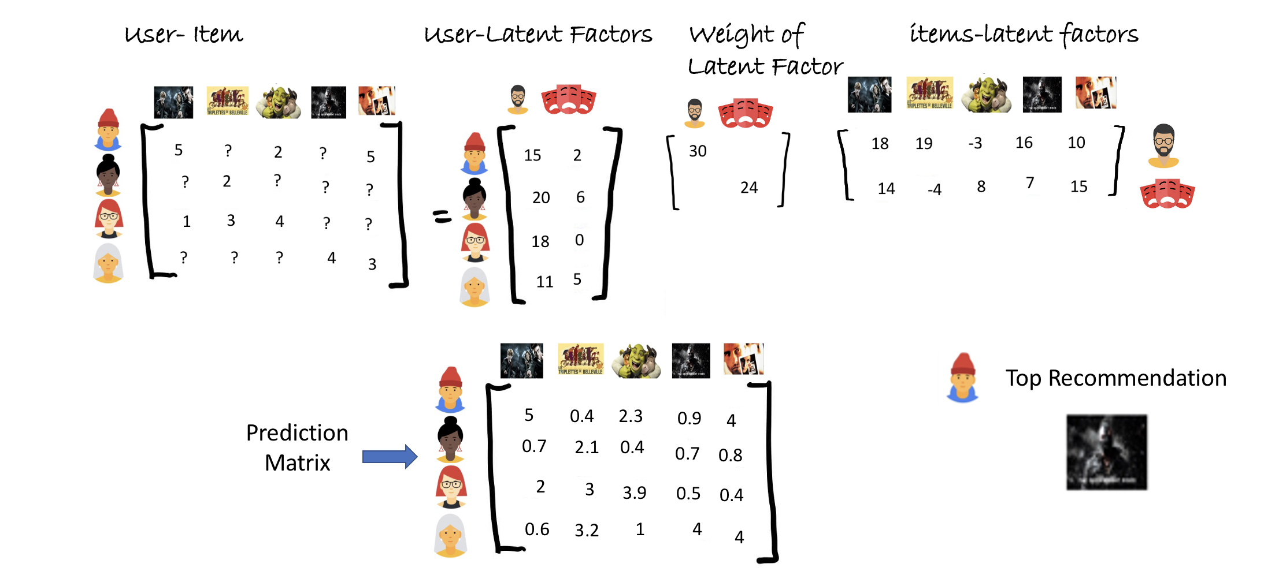
SVD Recommendations:

Slide 23
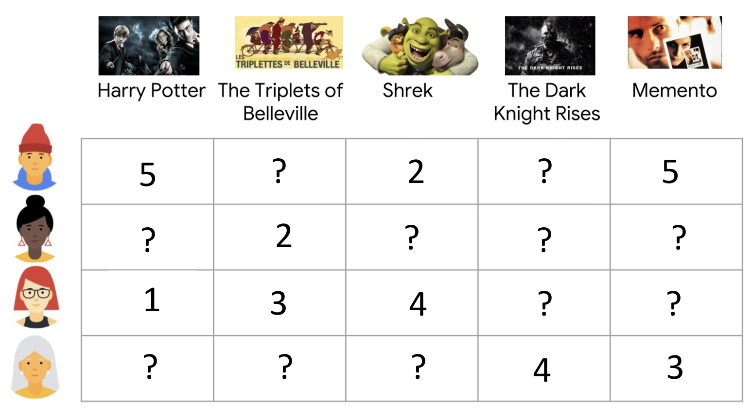
Can SVD work on this Matrix?

Slide 24
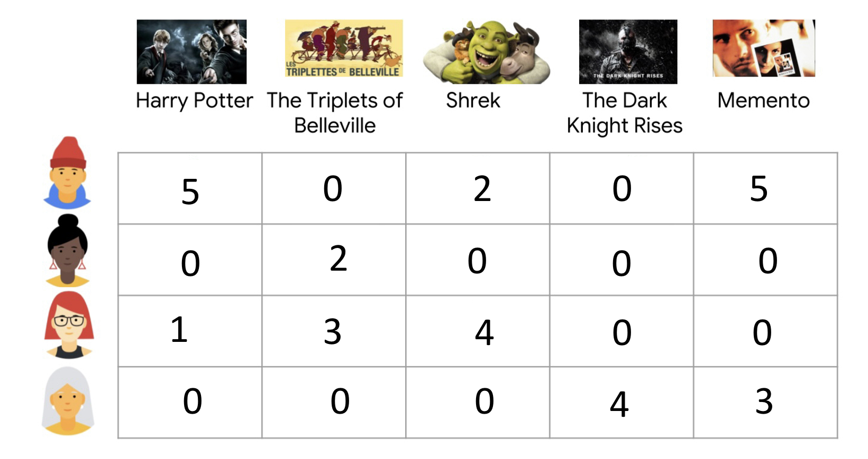
Fill Matrix with Zeros!

Slide 25
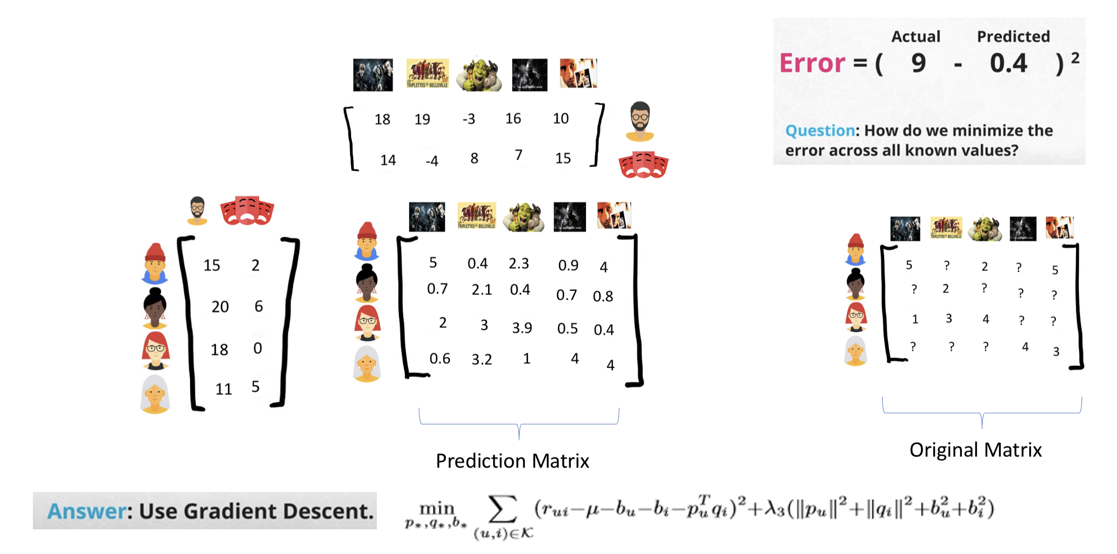
Funk SVD:
2
2.3

Slide 26
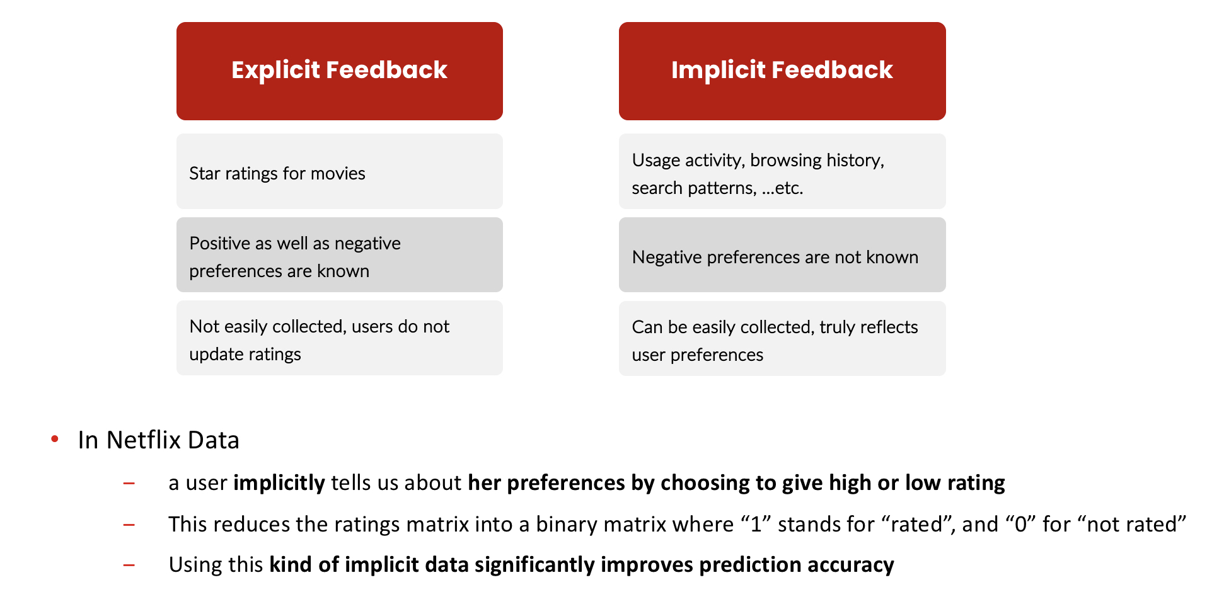
User Feedback:

Slide 27
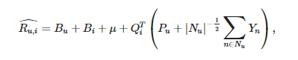
SVD++:
Explicit Feedback
+
Implicit Feedback
1
1
1
1
1
1
1
1

Slide 28
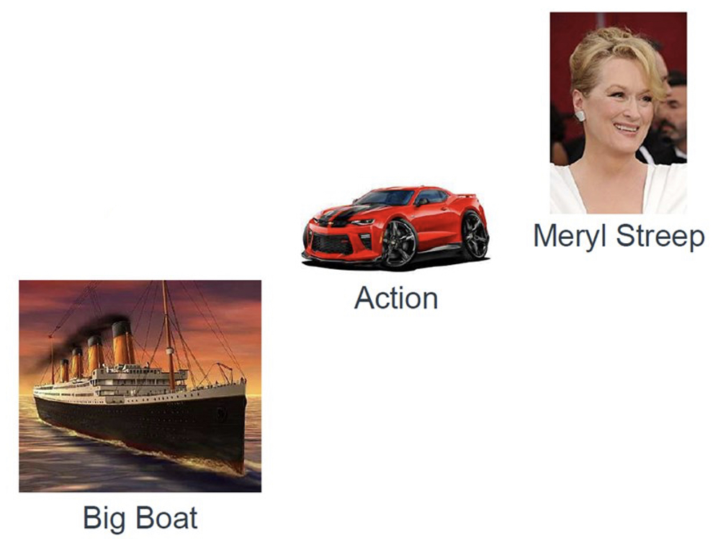

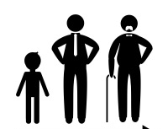



Explicitly define latent factors:
Movie Factors
User Factors
Context Factors

Slide 29
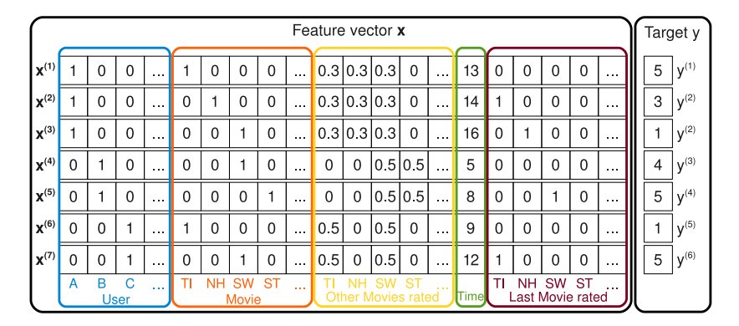
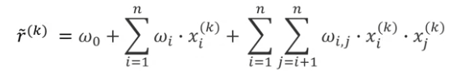
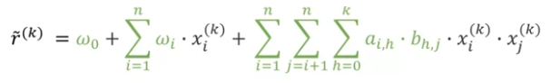
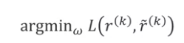
Factorization Machines:

Slide 30
Experimental Results

Slide 31
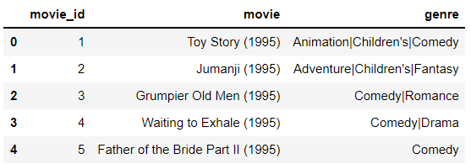

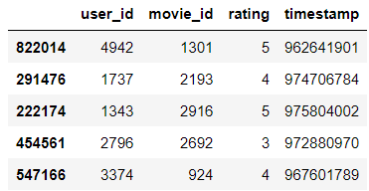
Dataset: Movie Lens
6000 Distinct Users
4000 Distinct Movies
1M Movie Ratings
Movies Dataset
Ratings Dataset

Slide 32
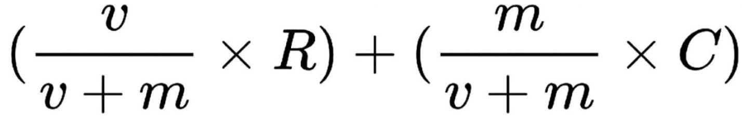
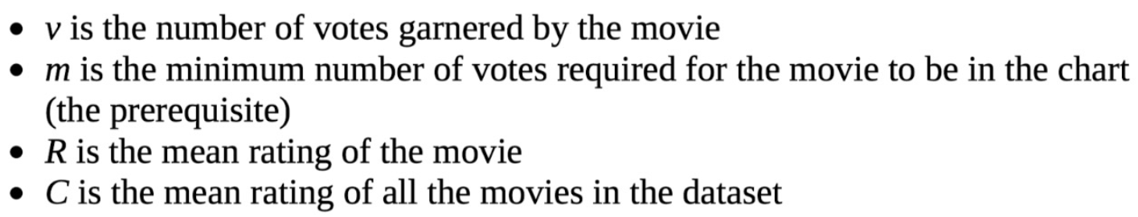
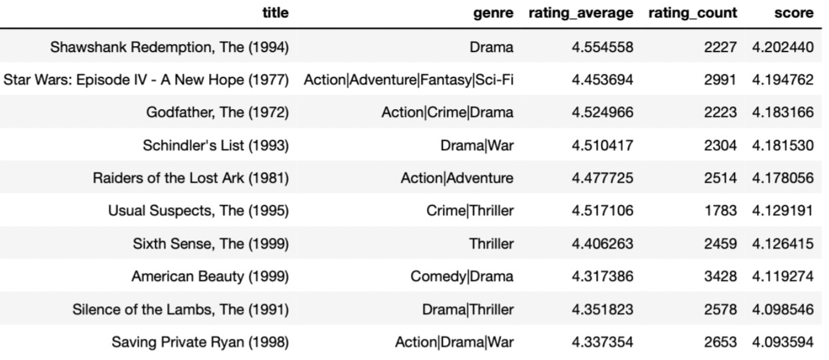
Rank Based Recommendation:

Slide 33
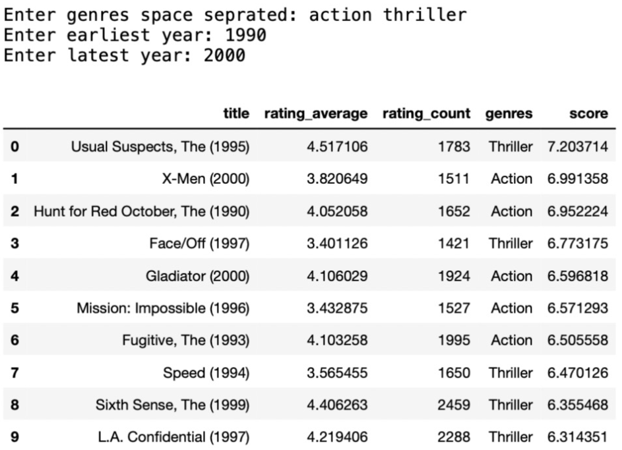
Knowledge Based Recommendation:

Slide 34
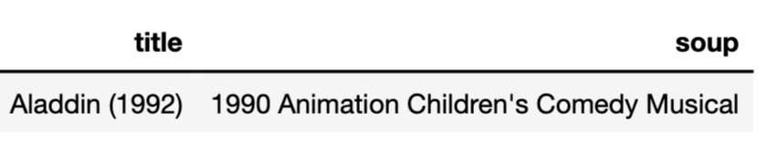
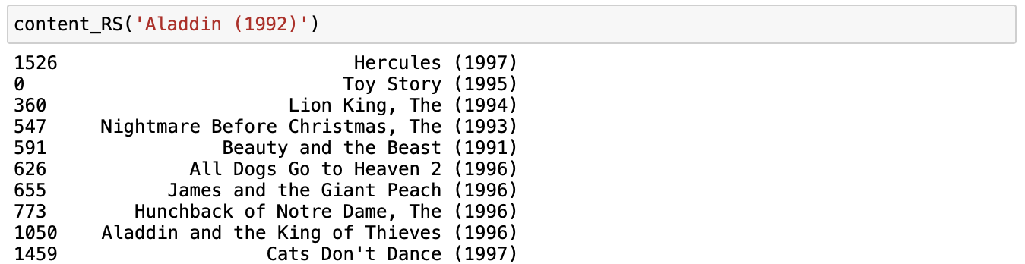
Content-Based Recommendations:

Slide 35
Evaluation:
Model | RMSE
Normal Predictor | 1.5085
Item Based CF with Cosine Sim | 1.0017
Item Based with Pearson Baseline | 0.9842
User Based CF with Cosine Sim | 0.9774
Baseline Estimate | 0.9087
SVD | 1.1410
Funk SVD | 0.8797
SVD++ | 0.8676
Factorization Machine | 1.2165

Slide 36
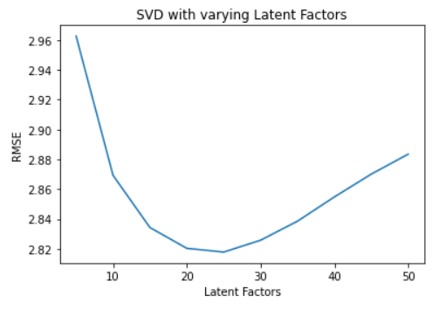
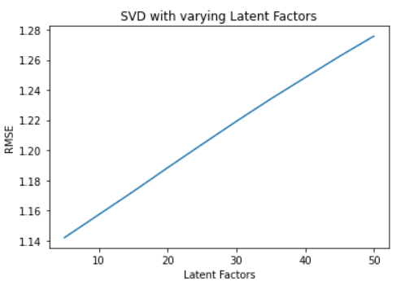
Evaluation: SVD with zeros & SVD with mean vs. Latent Factors

Slide 37
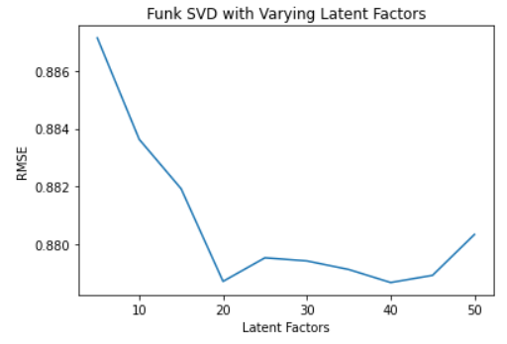
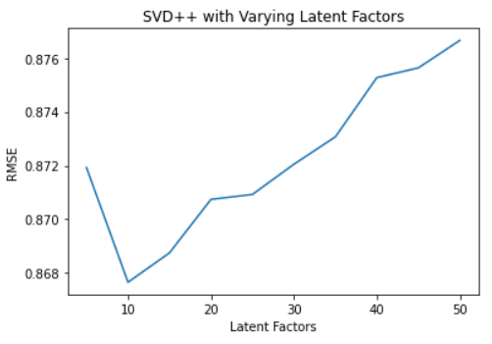
Evaluation: Funk SVD & SVD++ vs. Latent Factors

Slide 38
Conclusion

Slide 39
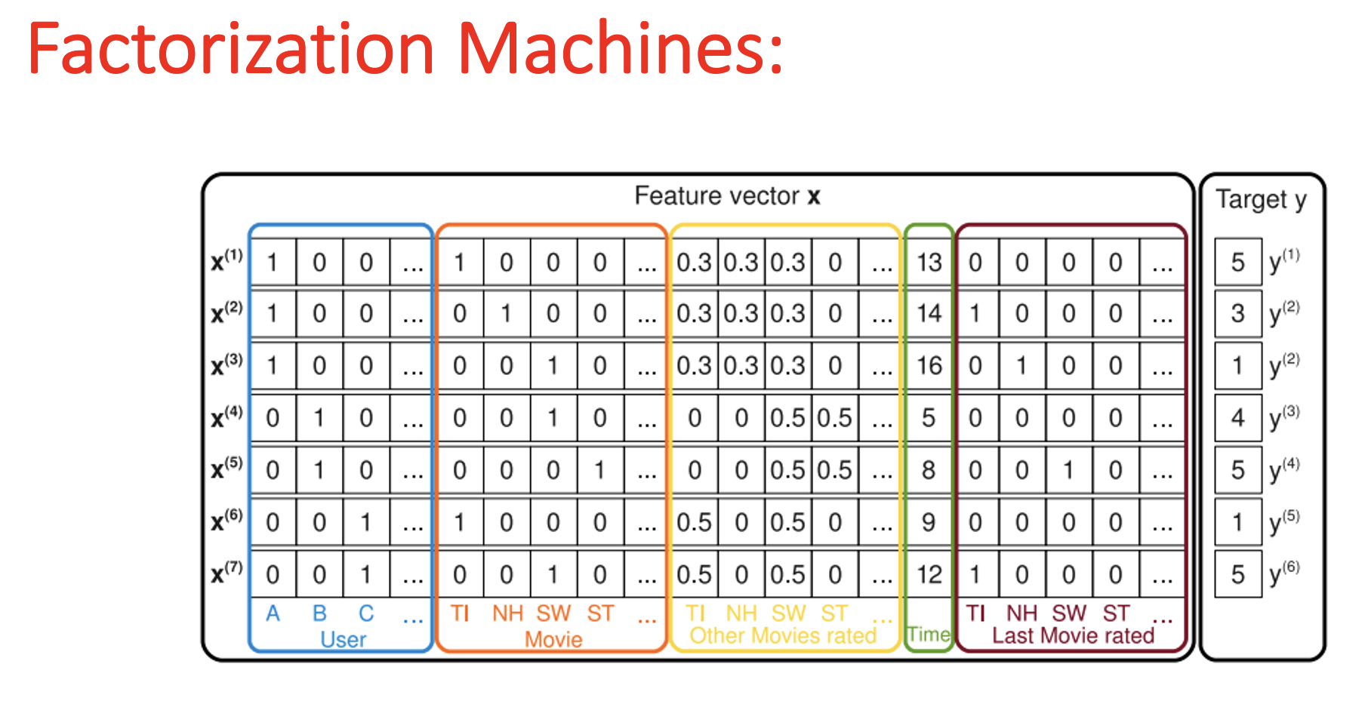
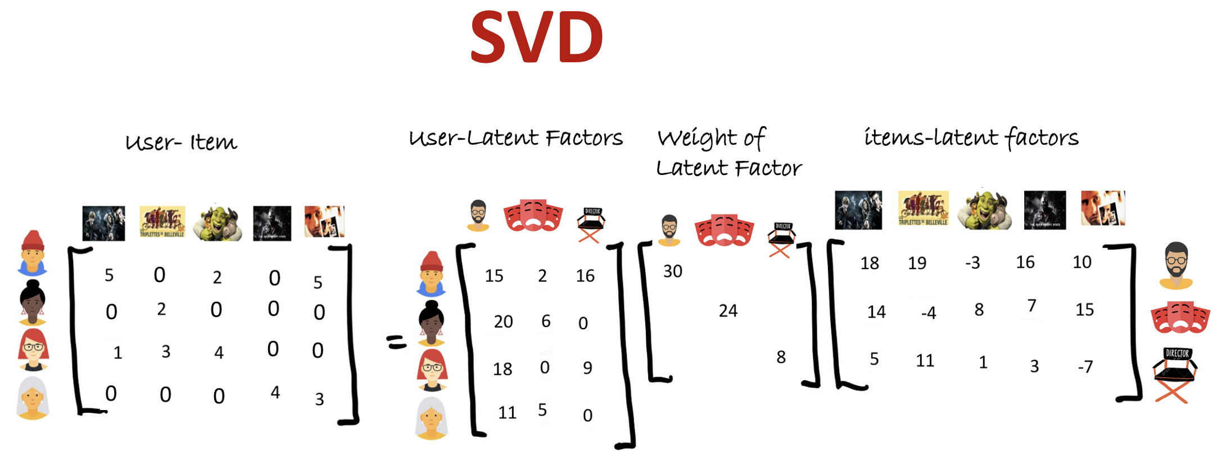
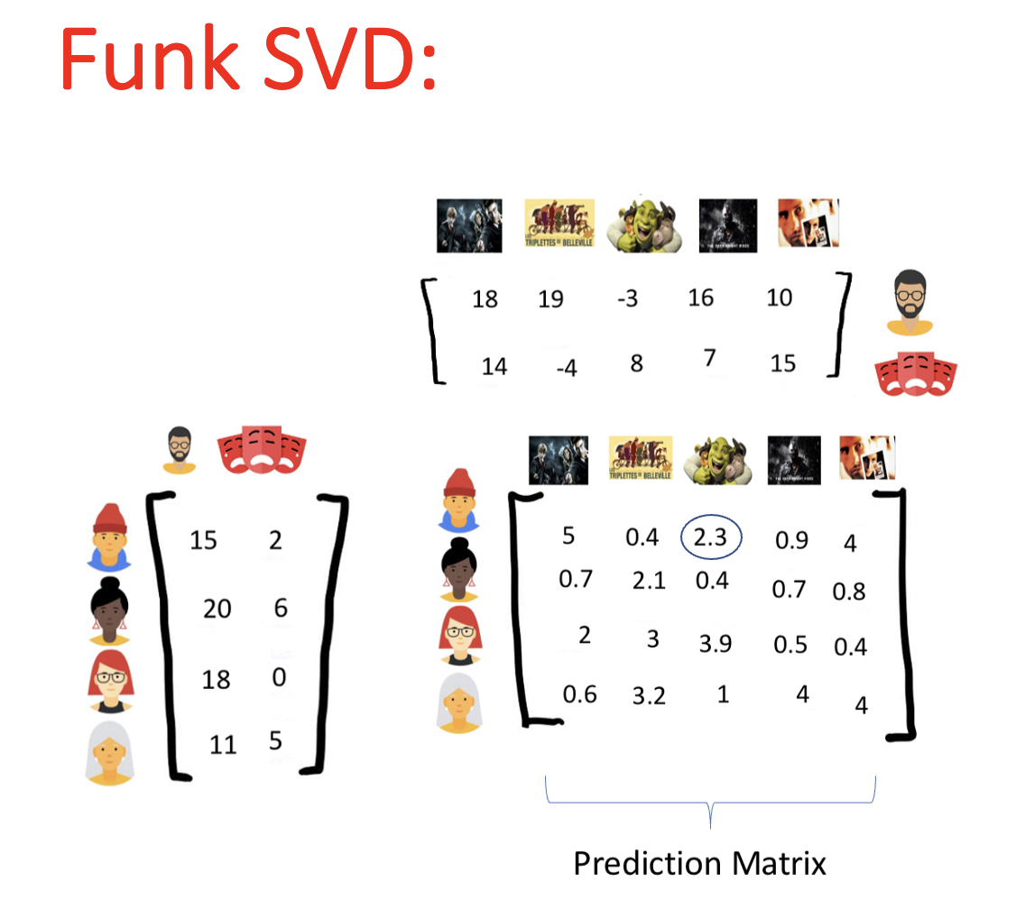
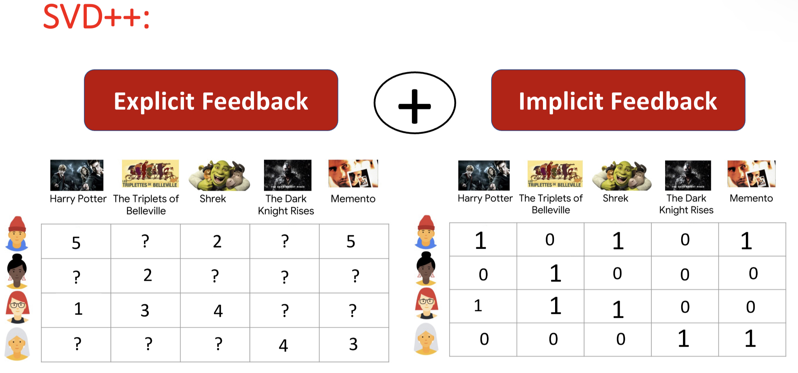
No assumptions
Define Features
Implicit
Feedback

Slide 40
Future Research Directions

Slide 41
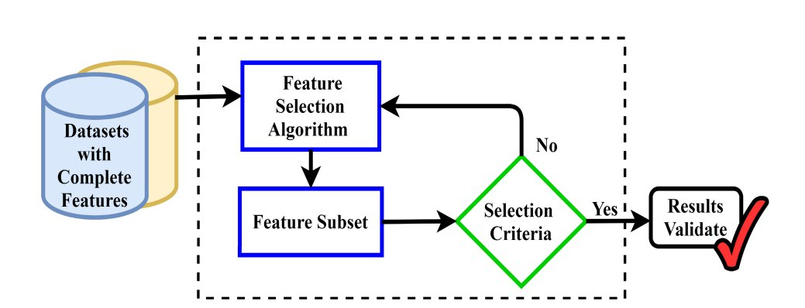
Feature Selection:
P.Agrawal et al.: Metaheuristic Algorithms on Feature Selection: A Survey of One Decade of Research (2009-2019)

Slide 42
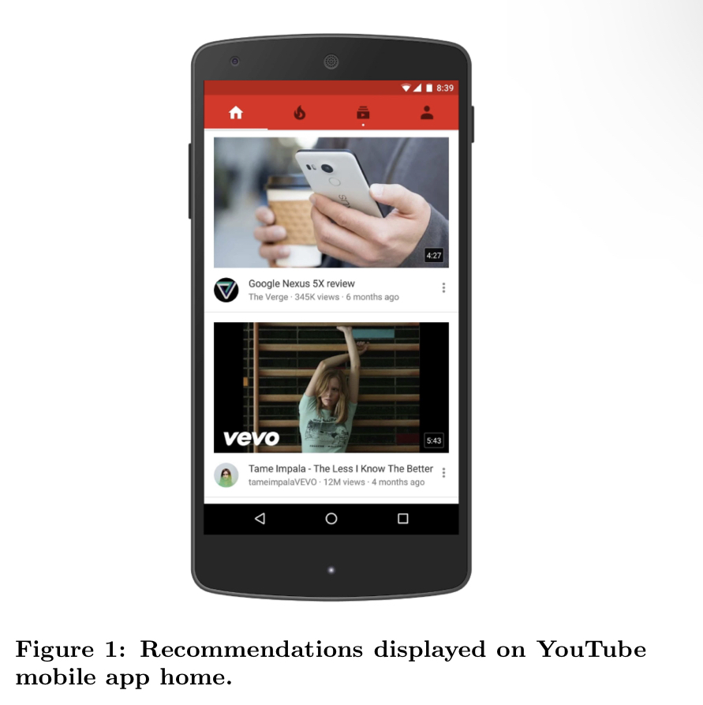
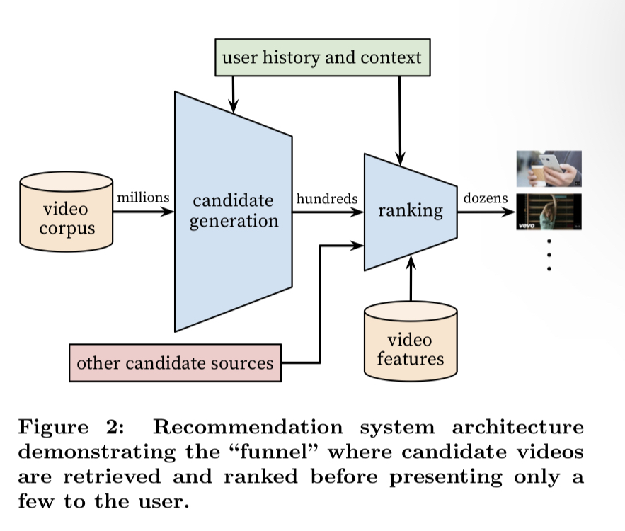
Deep Neural Networks for YouTube Recommendations:

Slide 43
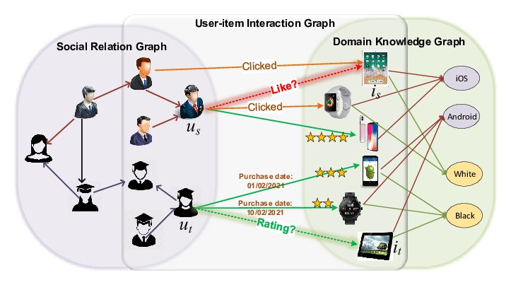
Graph Neural Networks for Social Recommendation:

Slide 44

Future Research and Directions:
Is RMSE the best metric for Evaluation?

